Slide 1
QF624 Machine Learning and Financial Applications Project
Group 2:
Wang Li
Aloysius Voo
Qu Wenqin
Jeriel Wong
Bryan Seah

Slide 2
Business Problem & Objective
Conventional methods used to predict stock price returns rely heavily on numerical data, and cannot fully utilise all the available information about a company.
These were noted to be highly dependent on the type of stocks whose returns were being predicted.
Cazalet and Roncalli (2014) found that one of the issues with the Fama-French risk factors is the value premium, which is larger for small stocks in general.
Cremers and Zitzewitz (2013) found that the Fama-French factors placed a disproportionate weight on small value stocks.
Lambert and Hübner (2014) found that this was a result of a theoretical bias in the definition of the premium.
Notes:
These findings suggest that there may be certain biases or limitations in the definition or calculation of the value premium within the Fama-French framework.

Slide 3
Business Problem & Objective
To address the limitations of conventional methods, there have been increased studies on the usage of machine learning (ML) models to predict stock returns.
Apply linear regression models to predict stock returns
Application of deep neural networks, specifically long short-term memory (LSTM) networks for stock return prediction
Financial markets also generate large amount of unstructured data including news articles, company presentation and more.
Thus, we seek to determine whether stock price movements can be predicted with natural language processing (NLP) techniques to analyze earning call transcripts/conference presentation to increase alpha from trading strategies.

Slide 4
Data
Population and source
META, AAPL, GOOGL, NFLX, AMZN
Period: Mar 2013 to Mar 2023
Quarterly financial ratios and multiples from CIQ, and US macroeconomic data from Bloomberg
Quarterly earnings transcripts from CIQ
Pre-processing of data
Input variables with more than 4 NaN values would be dropped with remaining missing data forward filled
All variables were normalised
Output variable
Quarterly returns computed from price data from yfinance

Slide 5
Methodologies
Linear Regression
Neural Network
Natural Language Processing (NLP)

Slide 6
Linear Regression
Split training-test dataset (80-20)
All of the input variables were used.
Separate regressions were trained for each ticker using different degrees of polynomial features (utilising sklearn.preprocessing.PolynomialFeatures).
Using all variables result in the issue of multicollinearity:
Potential overfitting
Increased difficulty in determining individual impact of each input variable on output variable

Slide 7
Regularisation
Both LASSO and ridge regressions were run separately for each ticker using different degrees of polynomial features.
Penalty would be added to the model's loss function to restrict coefficients, which would lead to zeroising / shrinkage of coefficients.
Thus, we expect the impact of multicollinearity to be reduced.

Slide 8
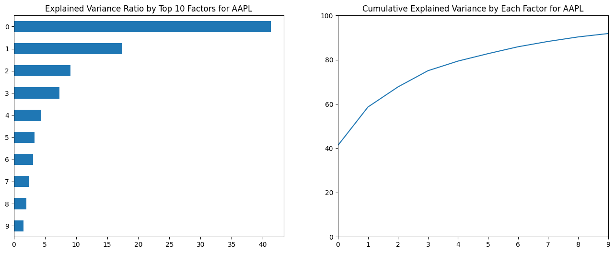
Principal Component Regression (PCR)
Principal component analysis: converts the existing input variables of the training set to linearly uncorrelated variables (i.e. principal components)

Slide 9
Principal Component Regression (PCR)
Resulting principal components cannot be directly interpreted.
Separate regression models were trained for each ticker by varying the number of PCs to be included in the model.
This allows us to determine the number of PCs that would give rise to the minimum RMSE.

Slide 10
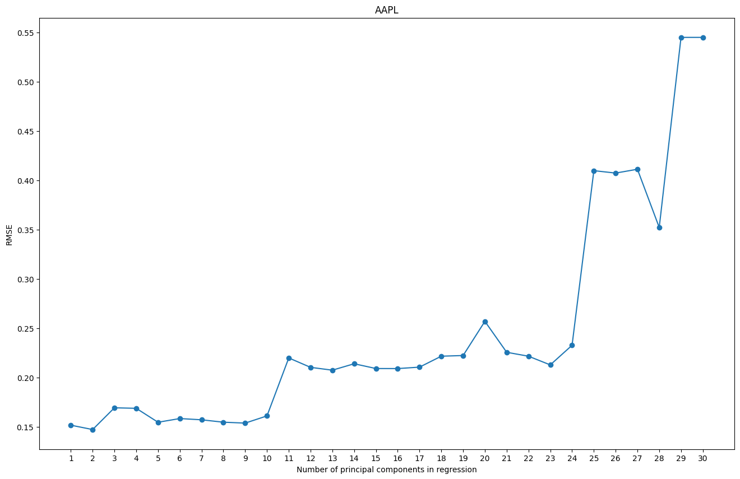
Principal Component Regression (PCR)
Min RMSE per testing set for AAPL is generated with 2 component(s)
Min RMSE per testing set for AAPL: 0.14753

Slide 11
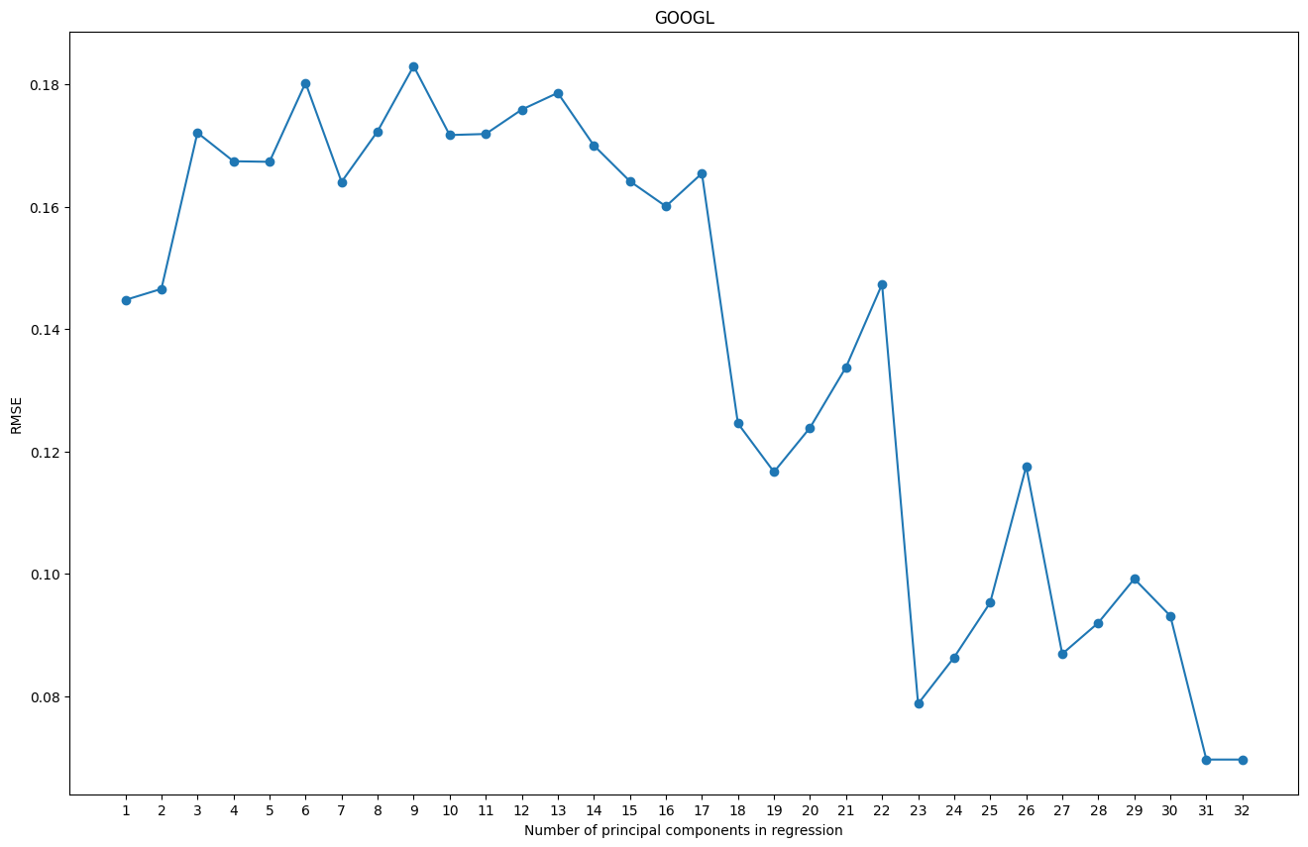
Principal Component Regression (PCR)
Min RMSE per testing set for GOOGL is generated with 31 component(s)
Min RMSE per testing set for AAPL: 0.06964

Slide 12
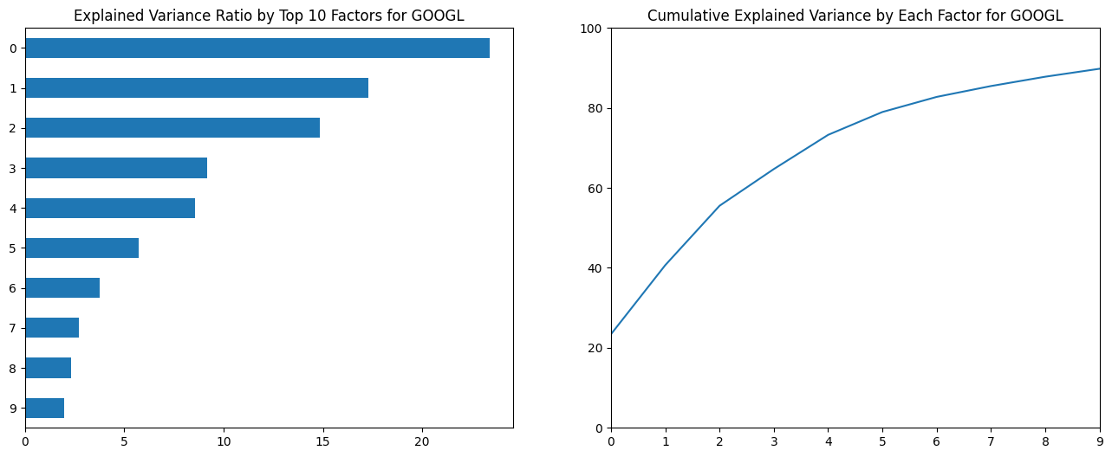
Principal Component Regression (PCR)

Slide 13
Recurrent Neural Network
Final Model hyperparameters:
two LSTM layers (128 neurons, 64 neurons)
Optimiser = ‘Adam’ with a learning rate of 0.0225
Batch_size = 4, epochs = 50
Standard Scaler for input data

Slide 14
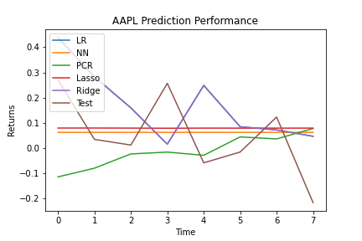
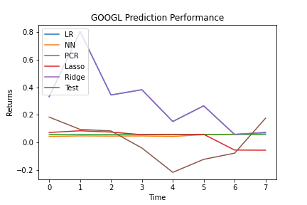
Benchmark Predictions

Slide 15
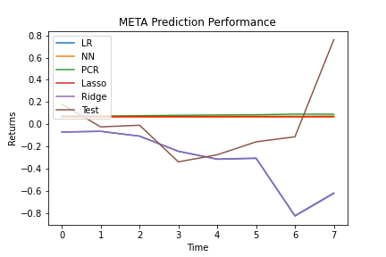
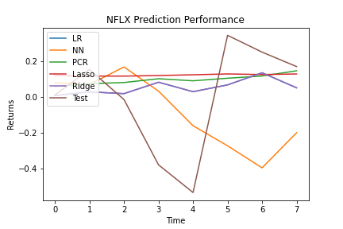
Benchmark Predictions

Slide 16
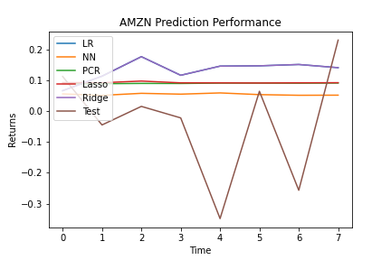
Benchmark Predictions

Slide 17
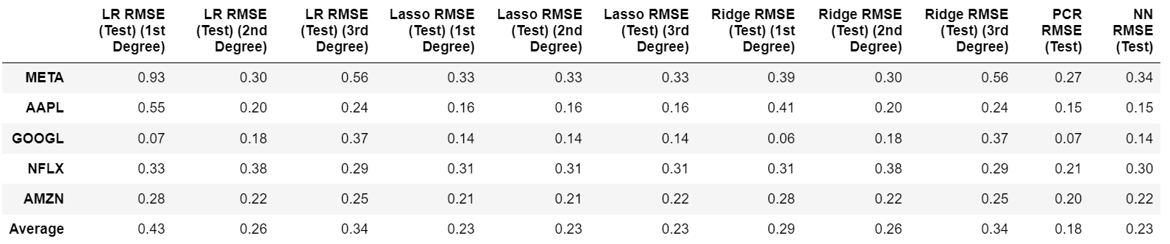
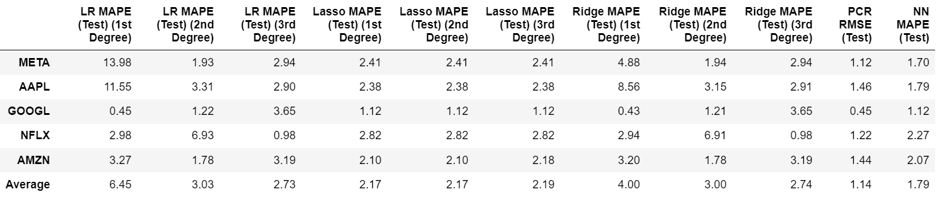
Evaluation
Model Performance - RMSE
Model Performance - MAPE

Slide 18
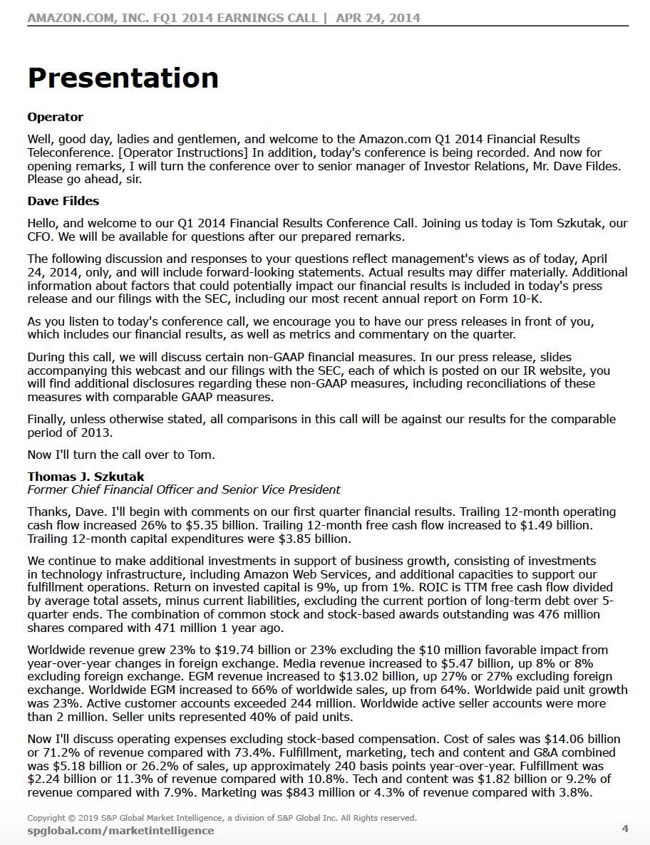
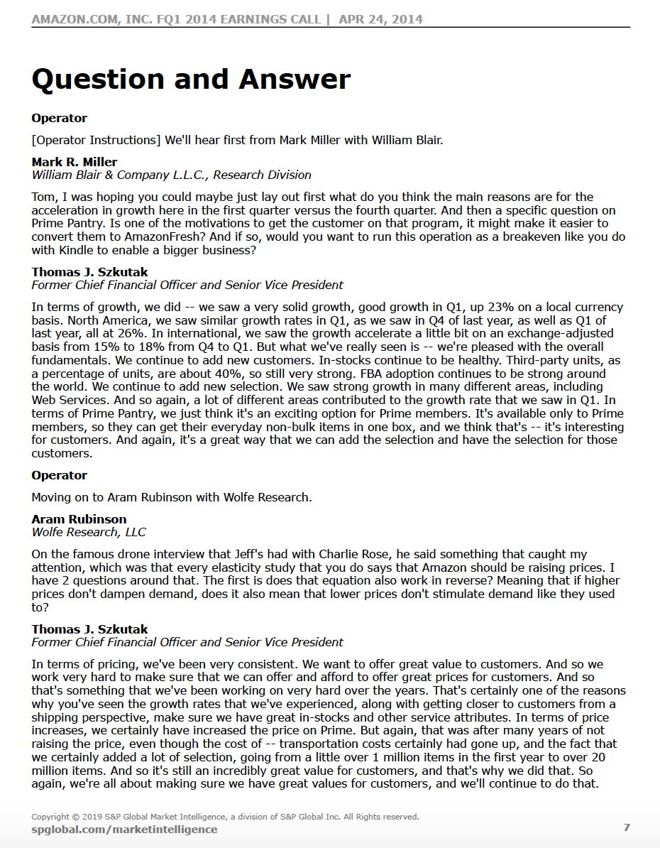
Natural Language Processing (NLP)
Quarterly earning calls transcripts (Presentation and Q&A) -> perform sentiment analysis -> forecast stock price movements
Company's financial performance, business operations, management's outlook, and address questions from analysts and investors
Sentiment analysis - understand if the tone of the transcripts is positive, negative, neutral, or contains other emotion value
The overall sentiment expressed in the call can then be used to help us decide if we should invest in the company’s stock

Slide 19
Natural Language Processing (NLP)
There are several open-source NLP packages available that provide powerful tools to perform various NLP tasks, including sentiment analysis. For example, TextBlob, Transformers etc.
Model | TextBlob (based on NLTK and pattern library) | FinBERT (a specialised BERT model in financial domain)
Advantages | - Simple and easy to use, with a straightforward API - Offers a lexicon-based sentiment analysis (word/phrase-level sentiment scores based on a predefined dictionary. Then aggregate to calculate the overall sentiment score for a sentence) - Does not require extensive computational resources - Provide a good starting point for analysis | - A State-of-the-art NLP model - Pre-trained on a large financial corpus, taking into account financial jargon and sentiment patterns - Offers domain-specific understanding and can provide better accuracy for financial sentiment analysis compared to general-purpose models
Limitations | - Relies on predefined rules, which may not capture the nuances and complexities of language - Limited in terms of advanced NLP capabilities and domain-specific understanding - May not provide high accuracy compared to more advanced models such as transformer-based models (e.g., BERT, GPT, RoBERTa) | - Requires computational resources and processing power - Requires labeled financial data for fine-tuning, which may be challenging to obtain

Slide 20
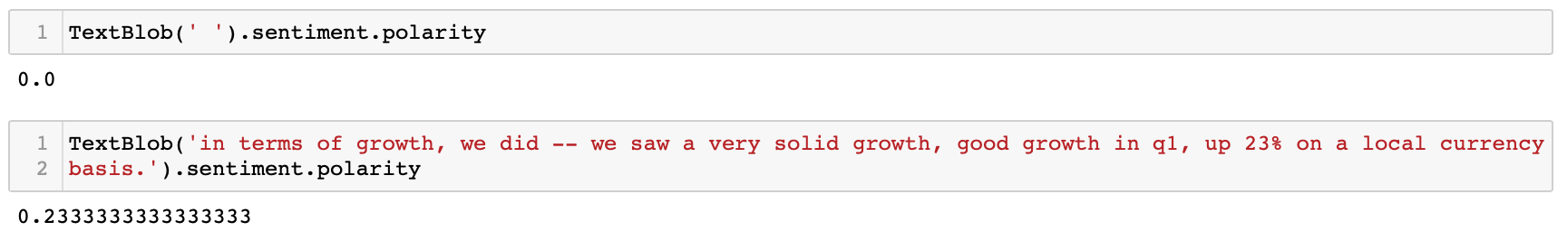
TextBlob
TextBlob sentiment analyser can return two properties for a given input
Polarity
refers to the sentiment expressed in a text, whether it is positive, negative, or neutral
takes a float score between [-1 , +1]. -1 suggests highly negative, +1 suggests highly positive, 0 suggests neutral
Subjectivity
measures how subjective or objective a text is
takes a float score between [0, +1]. 0 suggests maximum objectivity and +1 suggests highly subjective

Slide 21
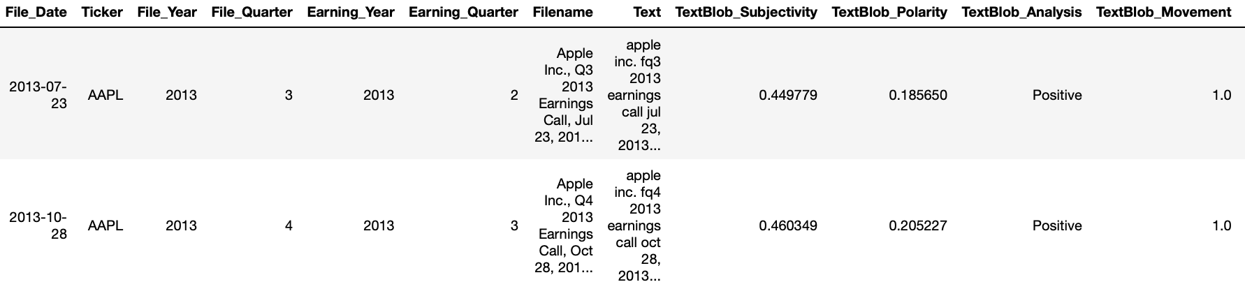
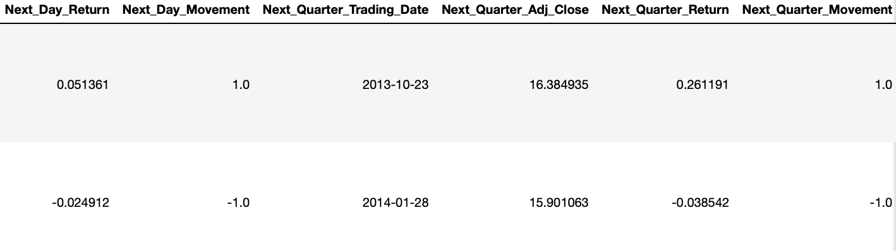
TextBlob
Data pre-processing (removing duplicate characters, multiple whitespaces, and stopwords)
Get the average polarity score of each transcript of a particular date to predict the future stock price movement
Compare to the actual historical stock price movement for the next day and the next quarter
Limitations: ( data noise - Q&A split; model limitation )
Ticker | AAPL | AMZN | GOOGL | META | NFLX
Next Day Movement Prediction Accuracy | 55.26% | 47.37% | 60.53% | 65.79% | 63.16%
Next Quarter Movement Prediction Accuracy | 68.42% | 60.53% | 60.53% | 63.16% | 65.79%

Slide 22
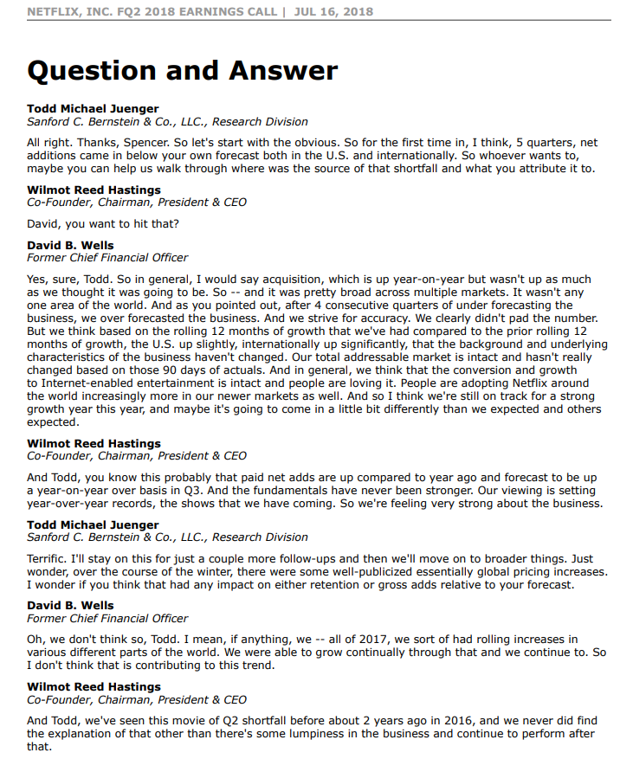
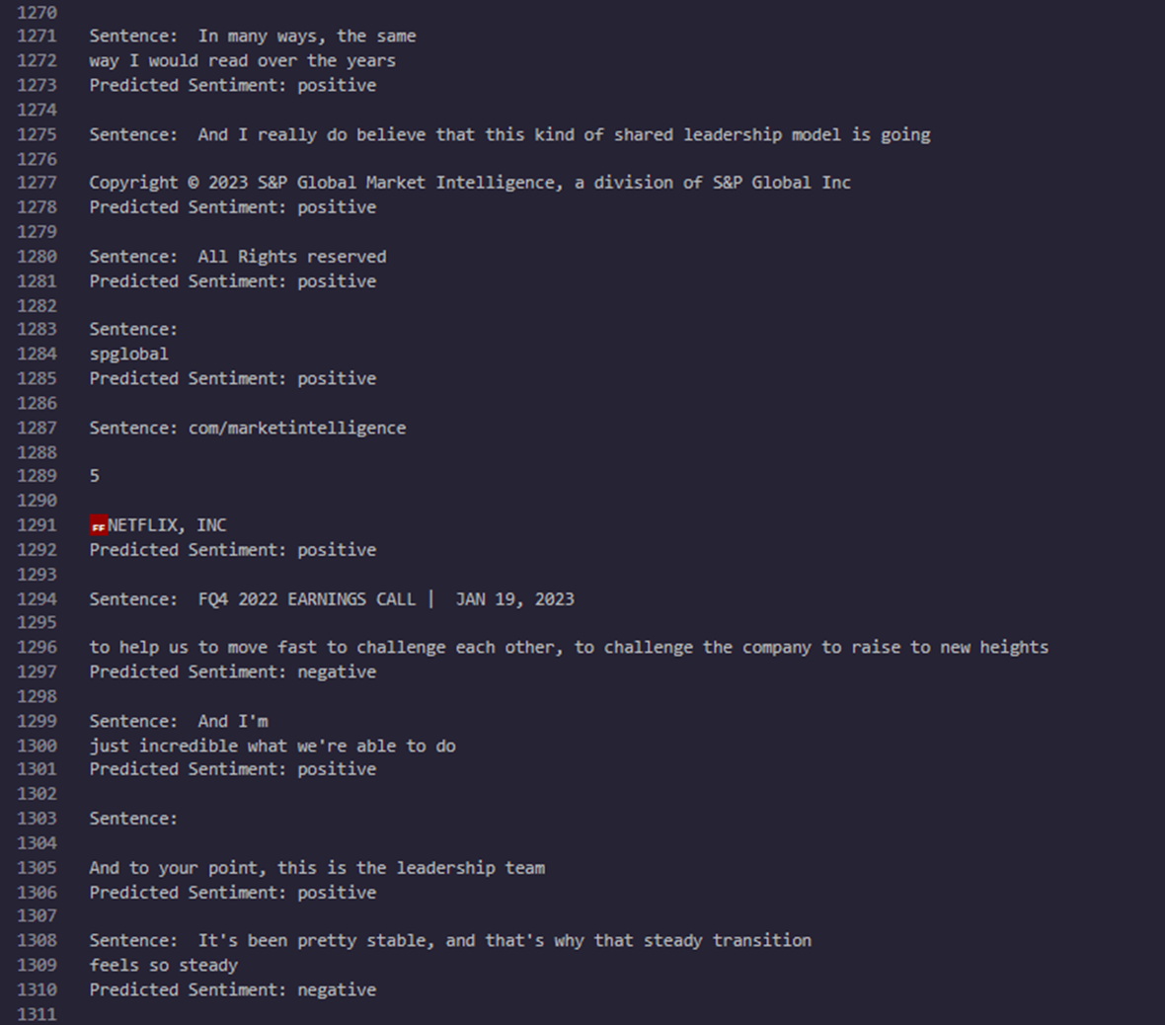
FinBERT
Earnings Call Transcript Question and Answer
Applied FinBERT on every sentence in Answers for each Question
If scope not defined, a lot of white spaces are deemed positive sentiment

Slide 23
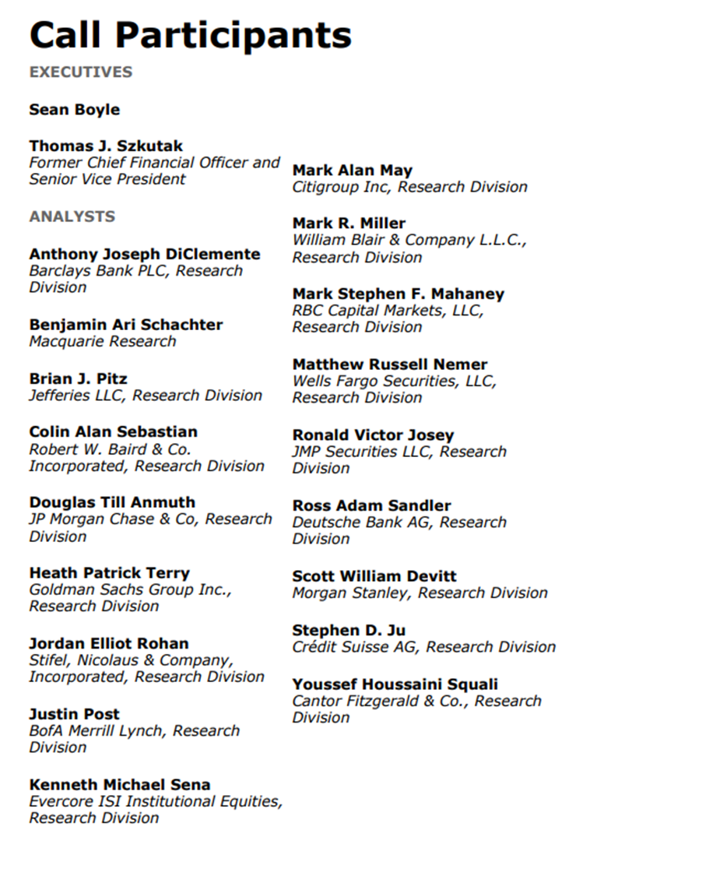
FinBERT - Defining Question and Corresponding Answer 2

Slide 24
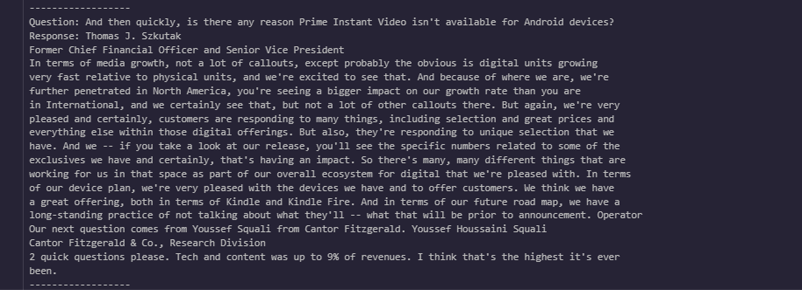
FinBERT - Defining Question and Corresponding Answer 2
Find sentences that ends with ? Till the next ?
Any sentences in between ends with . based on the above criteria
Will be mapped as a corresponding question-response

Slide 25
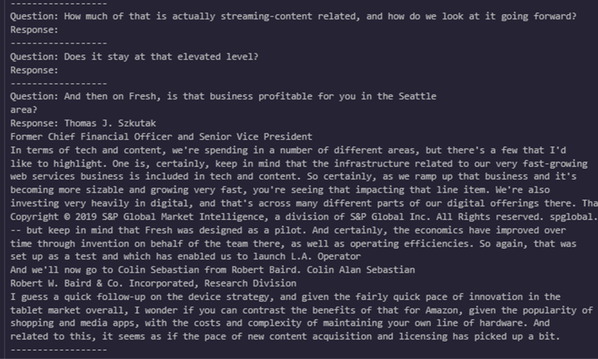
FinBERT - Interesting Findings
2 sub-questions in a Question
Question ends with a .
Inability to group such statements as a single question

Slide 26
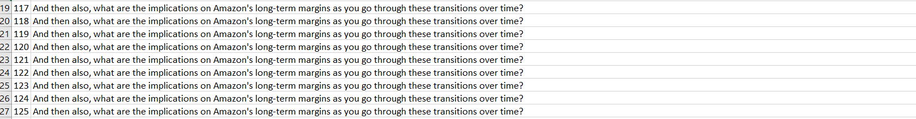

Slide 27
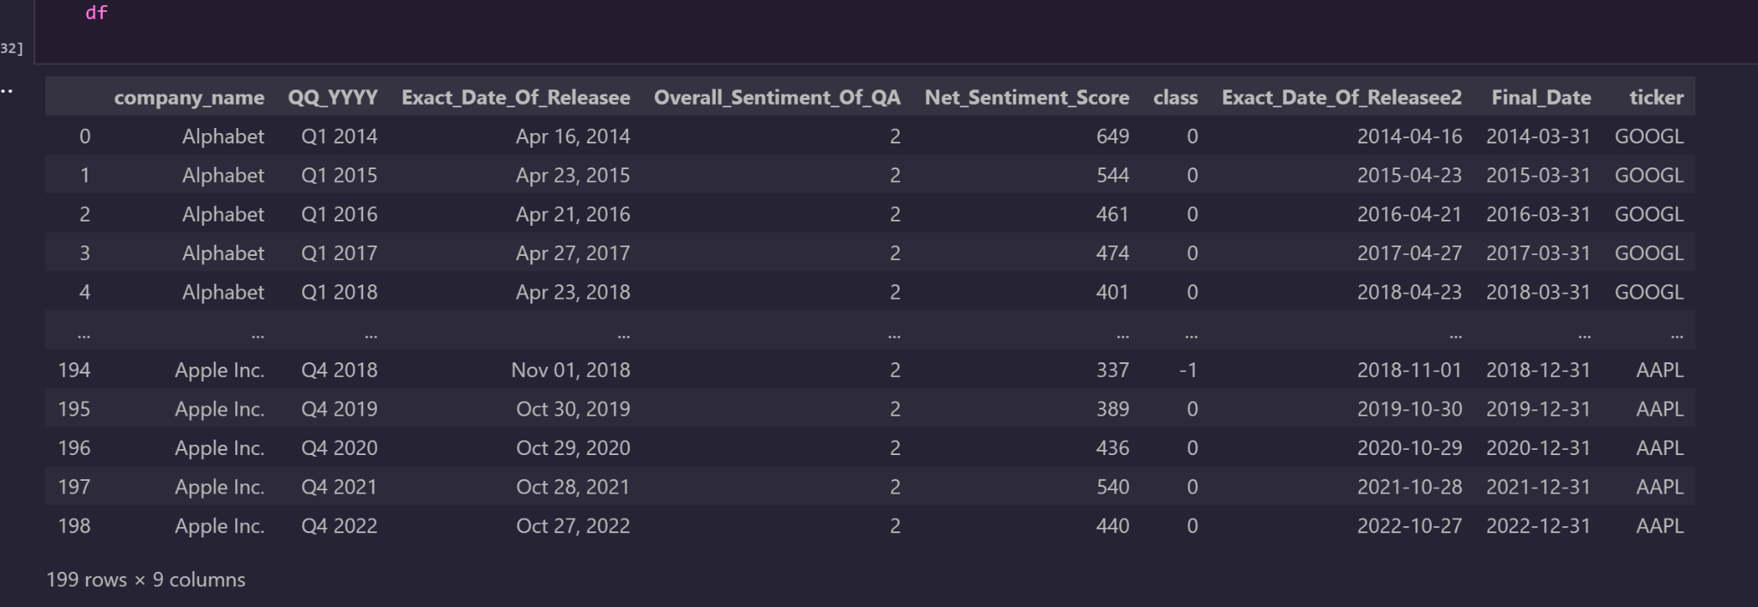
Results

Slide 28
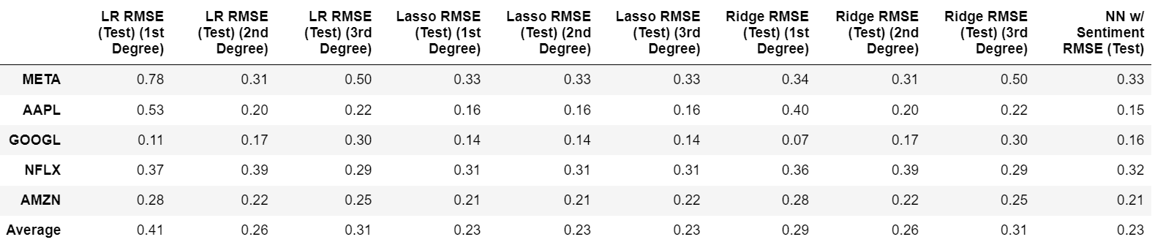
Evaluation
Model Performance - RMSE
Model Performance w/ Sentiment Scores - RMSE

Slide 29
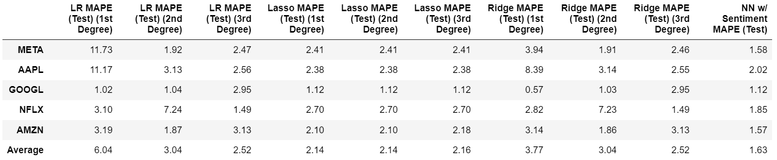
Evaluation
Model Performance - MAPE
Model Performance w/ Sentiment Scores - MAPE

Slide 30
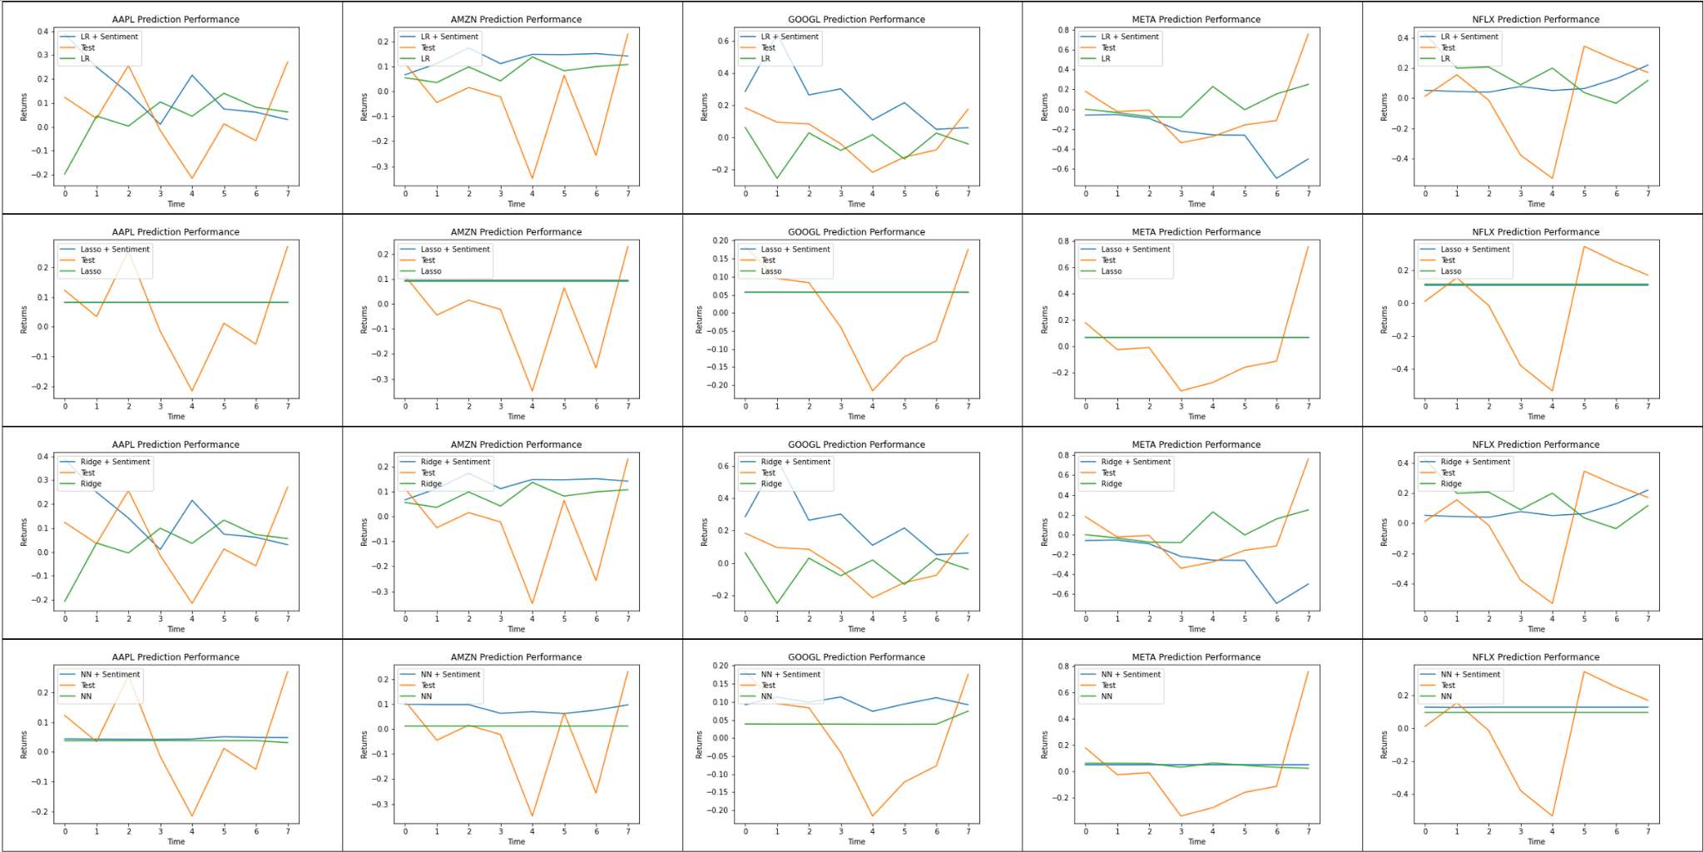
Comparison of model predictions

Slide 31
Conclusions / Observations
Areas for further exploration
Sentiment analysis on its own had decent prediction accuracy (next day / quarter)
However, adding sentiment analysis into our benchmark ML models did not improve performance.
Top performing predictions were not particularly meaningful - constant predictions/small variance.
Extending sentiment analysis to non-company published text (i.e. news articles, twitter, analyst reports) would allow modelling on shorter time slices (monthly/weekly/daily).
Increasing sample size beyond 10 years using the same methodology.

Slide 32
Q&A
Thank you :)

Slide 33
Appendix

Slide 34
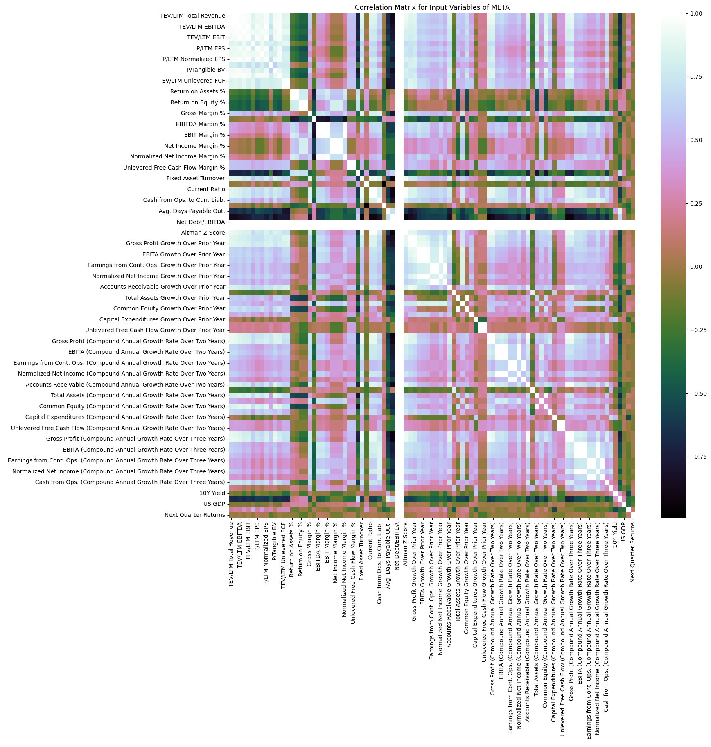
Correlation matrix (META)

Slide 35
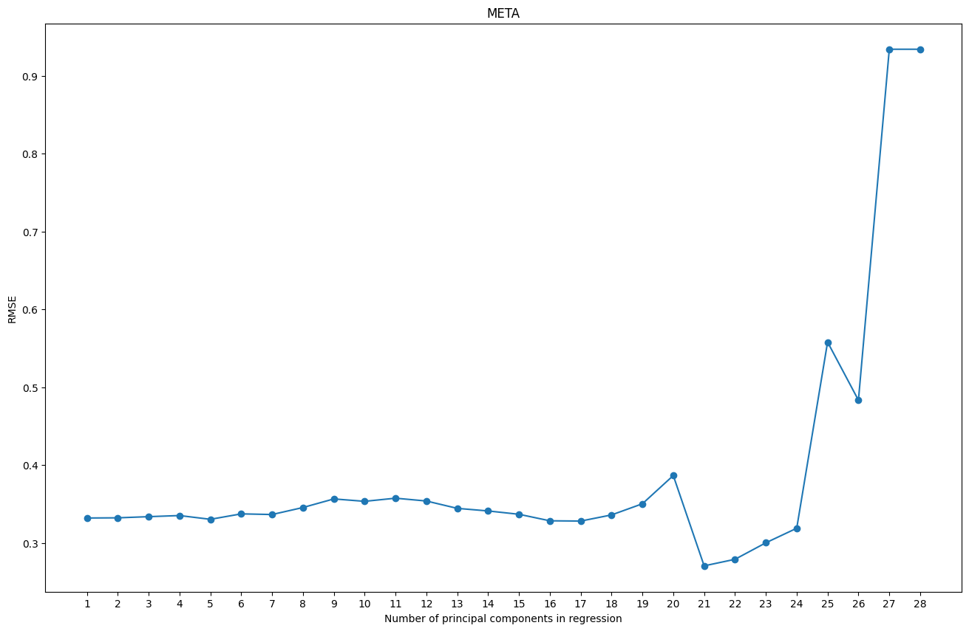
Principal Component Regression - RMSE (META)
Min RMSE per testing set for META is generated with 21 component(s)
Min RMSE per testing set for META: 0.27076

Slide 36
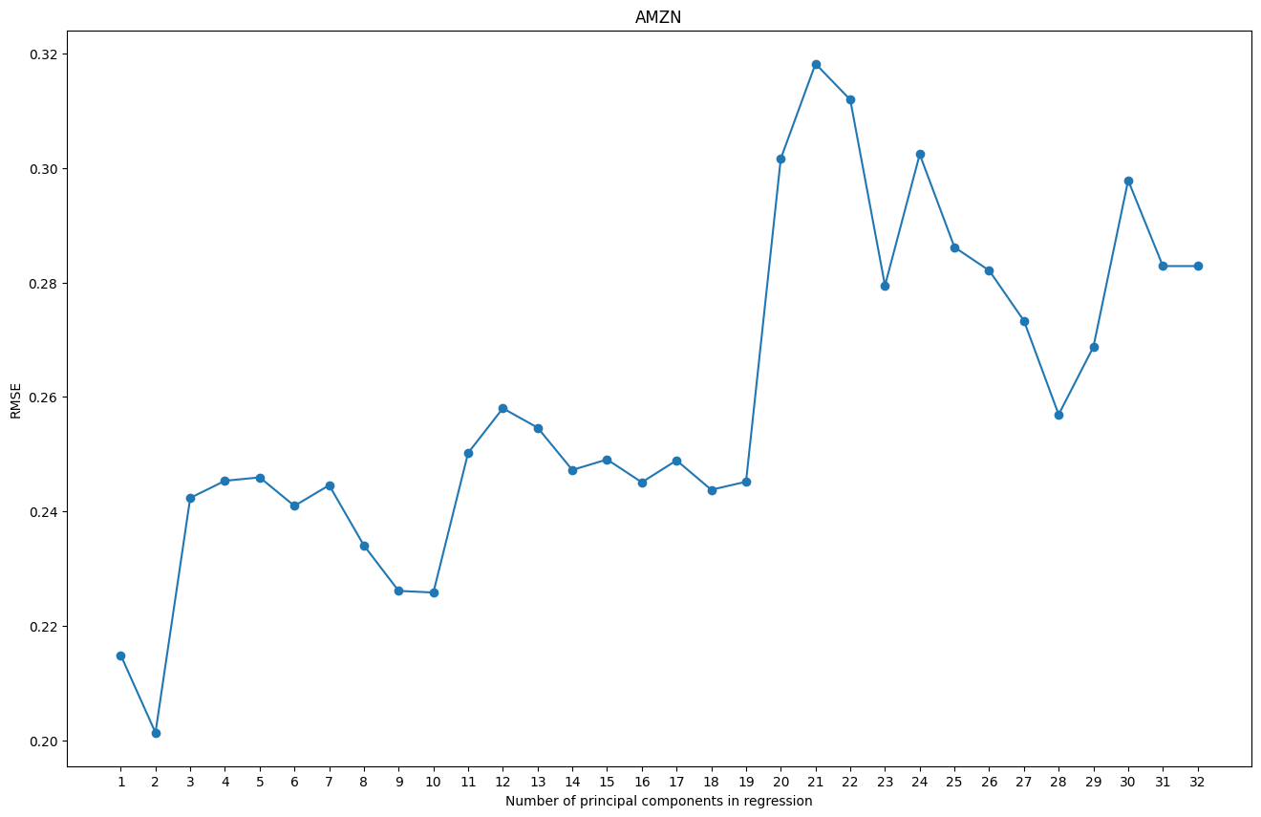
Principal Component Regression - RMSE (AMZN)
Min RMSE per testing set for AMZN is generated with 2 component(s)
Min RMSE per testing set for AMZN: 0.20132

Slide 37
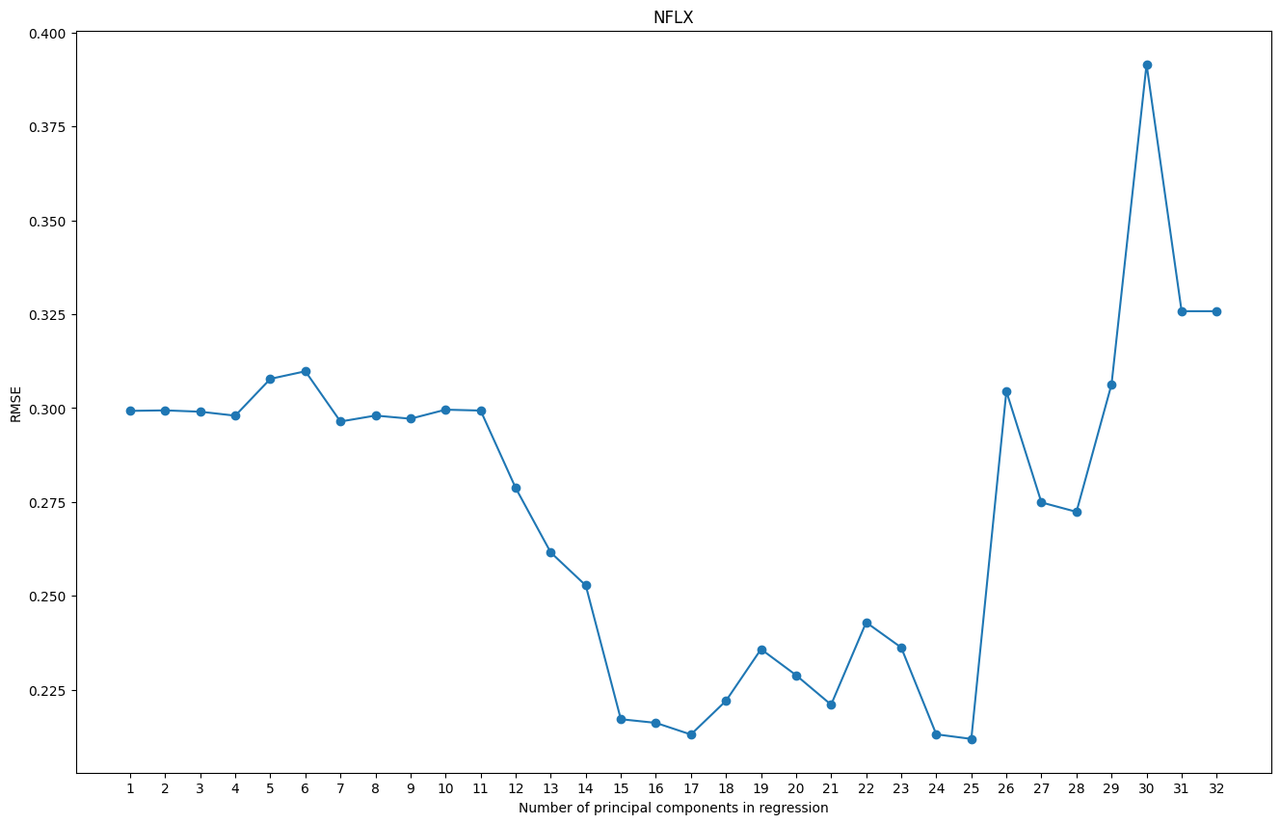
Principal Component Regression - RMSE (NFLX)
Min RMSE per testing set for NFLX is generated with 25 component(s)
Min RMSE per testing set for NFLX: 0.21191

